Slide 1
COM S 352 Operating Systems
Lecture 29: Security Basics

Slide 2
Cryptography
Goal: keep information from those who aren’t supposed to see it
Do this by encrypting the data
Encryption constrains the set of possible receivers of a message
Algorithms have two inputs: data and key(s)
Some keys must be kept secret
A good encryption algorithm should never depend on the secrecy of its implementation (assume attackers know the details of the algorithm), only the keys are secret

Slide 3
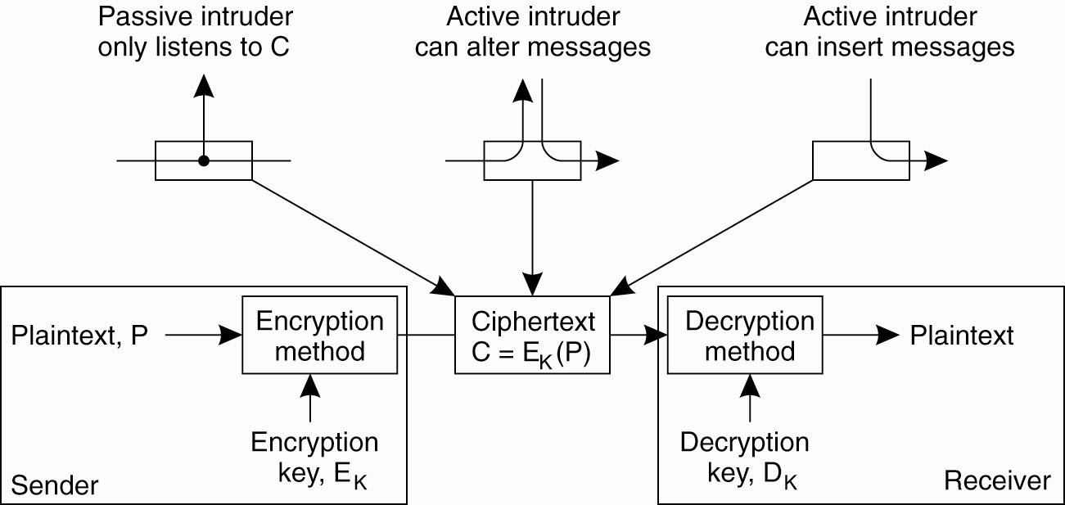
Basics of Cryptography
plaintext: unencrypted message
ciphertext: encrypted form of message

Slide 4
Cryptosystems
Cryptosystems are either symmetric or asymmetric
Symmetric system: E_{k} = D_{k}, so the key must be kept secret
Asymmetric system (aka public-key system): E_{k} ≠ D_{k} , E_{k} can be made public; D_{k} is secret and can’t easily be derived from E_{k}
E_{k} is a public key
D_{k} is a private key

Slide 5
Symmetric Encryption Algorithms
Same key is used to encrypt and decrypt
Therefore key k must be kept secret
Data Encryption Standard (DES) was most commonly used symmetric block-encryption algorithm (created by US Government)
56-bit keys
Encrypts a block of data at a time, 64-bit block size
Keys too short so now considered insecure
In 2001 NIST adopted a new block cipher - Advanced Encryption Standard (AES)
Keys of 128, 192, or 256 bits, works on 128-bit blocks
A machine that could crack 56-bit DES in one second would take 149 trillion years to crack a 128-bit AES key!
Notes:
Must try 2^128 keys
NIST: National Institute of Standards and Technology

Slide 6
Asymmetric Encryption
Public-key encryption based on each user having two keys:
public key – published key used to encrypt data
private key – key known only to individual user used to decrypt data
Most common is RSA block cipher
No efficient algorithm is know for finding the prime factors of a number

Slide 7
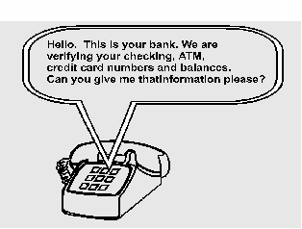
Authentication
Question: how does the receiver know that remote communicating entity is who it is claimed to be?
Notes:
The process or action of verifying the identity of a user or process

Slide 8
Authentication Protocol (AP)
AP 1.0
Alice to Bob: “I am Alice”
Problem: intruder “Trudy” can also send such a message
AP 2.0
Authenticate source IP address is from Alice’s machine
Problem: IP Spoofing (send IP packets with a false address)
AP 3.0: use a secret password
Alice to Bob: “I am Alice, here is my password” (e.g., telnet)
Problem: Trudy can intercept Alice’s password by sniffing packets

Slide 9
Authentication Protocol
AP 3.1: encrypt the password
Use a symmetric key known to Alice and Bob
A to B: “I am A”, and A’s encrypted password
B: if decrypted password is correct
then A is verified
else A is fraudulent
Failure scenario: playback attack
Trudy can intercept Alice’s message and masquerade as Alice at a later time

Slide 10
Authentication Using Nonces
Problem with AP 3.1: same password is used for all sessions
Solution: pick a "once-in-a-lifetime" number (nonce) for each session
AP 4.0
A to B: msg1 = "I am A" /* note: unencrypted message! */
B to A: once-in-a-lifetime value, n
A to B: msg2 = encrypt(n) /* use symmetric keys */
B computes: if decrypt(msg2)==n
then A is verified
else A is fraudulent

Slide 11
Authentication Using Public Keys
AP 4.0 uses symmetric keys for authentication
Question: can we use public keys?
Symmetry: DA(EA(n)) = EA(DA(n)), DA=private key of A, EA=public key of A
AP 5.0
A to B: msg = "I am A"
B to A: once-in-a-lifetime value, n
A to B: msg2 = DA(n)
B computes: if EA (DA(n))== n
then A is verified
else A is fraudulent

Slide 12
Problems with AP 5.0
Bob needs Alice’s public key for authentication
Trudy can impersonate Alice to Bob
Trudy to Bob: msg1 = “I am Alice”
Bob to Alice: nonce n (Trudy intercepts this message)
Trudy to Bob: msg2= DT(n)
Bob to Alice: send me your public key (Trudy intercepts)
Trudy to Bob: send ET (claiming it is EA)
Bob: verify ET(DT(n)) == n and authenticates Trudy as Alice!!
AP 5.0 is only as “secure” as public key distribution!

Slide 13
Digital Signatures Using Public Keys
Goals of digital signatures:
Sender cannot repudiate message ("I never sent that")
Receiver cannot fake a received message
Suppose A wants B to "sign" a message M:
B sends M and DB(M) to A
A checks if EB ( DB(M)) == M
If yes, then B has signed M
Notes:
Repudiate: fou3 ren4

